Slide 1
Project Name: Supply Chain Management Analytics
Manoj Kumar
Date:17 May 2026 to 14 June 2026

Slide 2
Group Details Team Members- Manoj Kumar Lalith Kumar S BINGI NARASIMHA Vaishnavi Ganesh Pansambal
Roles and Responsibilities:
Excel Data cleaning & Dashboard- Manoj Kumar & Lalith Kumar S
Power BI- Bingi Narashimha Tableau – Vaishnavi Ganesh Pansambal
SQL Analysis- Manoj Kumar

Slide 3
Project Summary: Objective Analyze supply chain performance and indentify opportunities to improve:
Revenue
Inventory Management
Supplier Performance
Delivery Performance
Impact
Reduce stockout risks
Improve supplier reliability visiblity

Slide 4
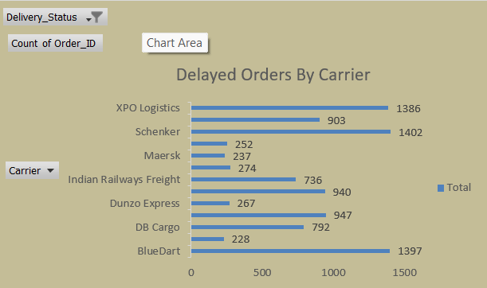
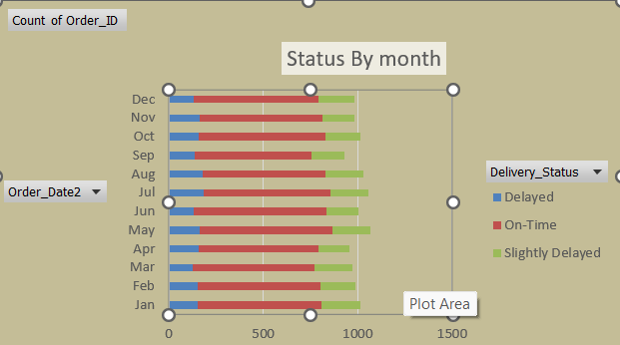
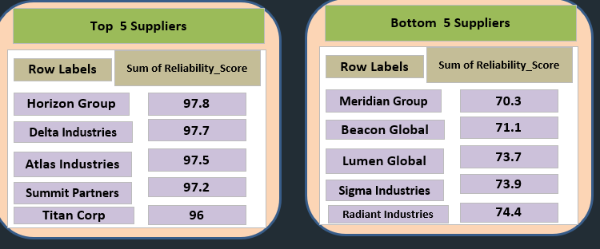
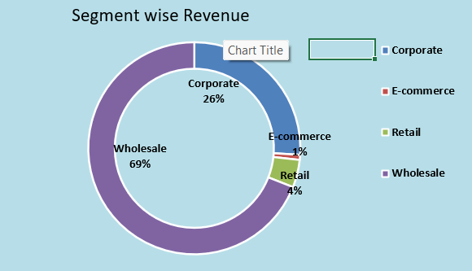
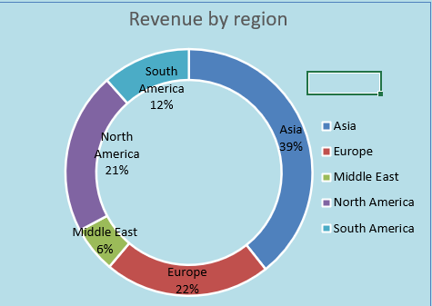
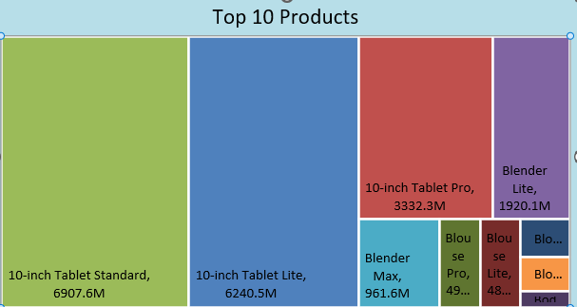
Excel Dashboard:

Slide 5
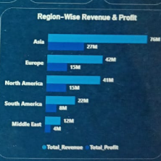
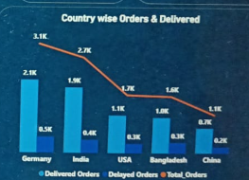
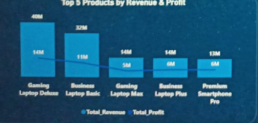
Power BI Dashboard:

Slide 6
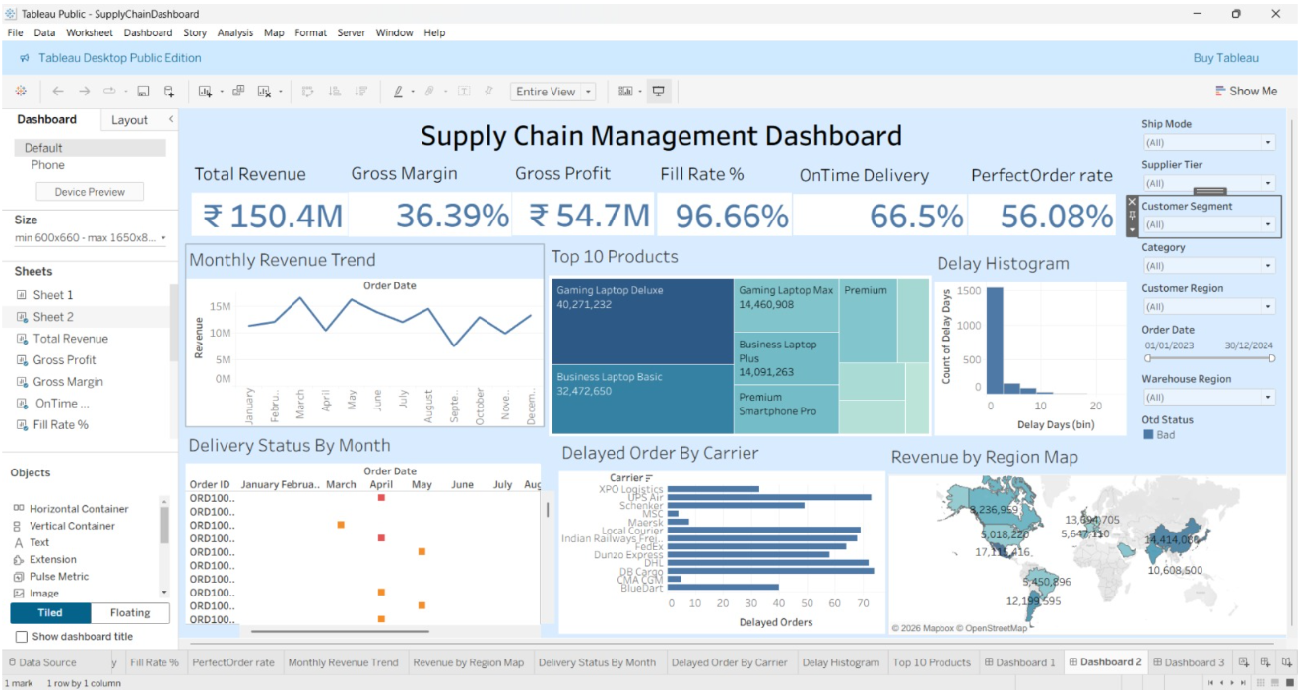
Tableau Dashboard:

Slide 7
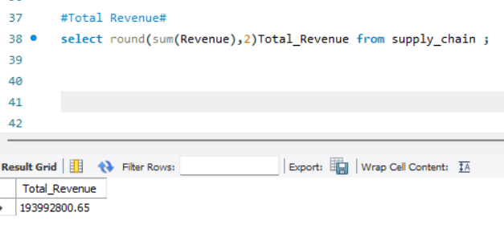
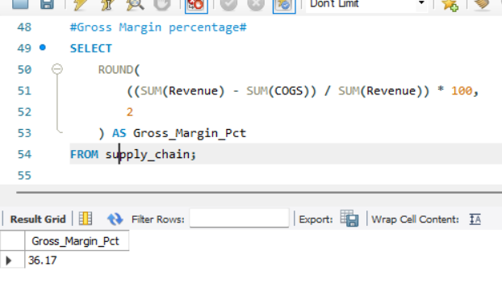
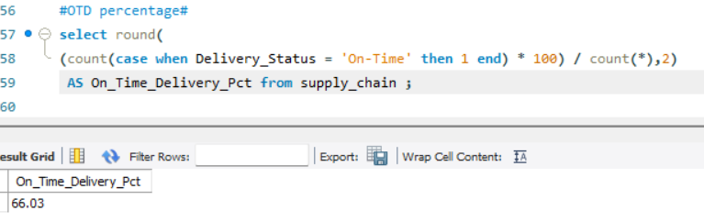
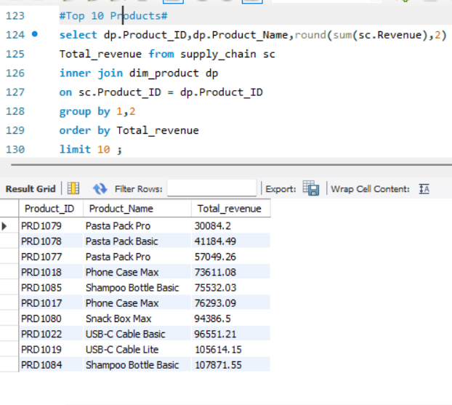
SQL Quarries:

Slide 8
Key Insights
Total Revenue reached 194M.
Gross Margin achieved 36%.
On-Time Delivery performance is 66%.
Fill Rate is 96.8%.
XPO Logistics and Schenker contribute the highest delivery delays.
Some suppliers show reliability below 75%, requiring attention.

Slide 9
Conclusion
This project demonstrates how Supply Chain Analytics can improve operational efficiency, inventory management, supplier performance, and customer satisfaction using Excel, SQL, Tableau, and Power BI.
Thank you Group 6

